Slide 1

Modeling Detailed Operations
Chapter 5-Part 2

Slide 2
Model 5-4: (s, S) Inventory Simulation
Setup
Different kind of model – not queueing
Textbook uses Blocks and Elements panels exclusively – SIMAN simulation language
  Mostly just to demonstrate this capability
  Could be done with higher-level panels we’ve been using
  We will do it with the higher-level panels as this is not a course in the SIMAN language.
  But, there are new modeling ideas here.
Company carries a single discrete item (widgets) in inventory
I(t) = inventory level (an integer) at time t days past the beginning of the simulation; I(0) = 60
Run simulation for 120 round-the-clock days

Slide 3
Model 5-4: (s, S) Inventory Simulation
Customer Demands Against Inventory
Customer interarrival times ~ EXPO (0.1) day (round the clock)
  First arrival not at time 0 but after an interarrival time past 0
Demand size is discrete random variable
  1, 2, 3, 4 with respective probabilities
  0.167, 0.333, 0.333, 0.167
If enough items are physically on hand in inventory to satisfy a demand, customer gets demand and leaves
If demand > number of items on hand, customer gets whatever is there and the rest of the demand is backlogged (I(t) becomes negative)
  If I(t) was already negative, it just goes more negative

Slide 4
Model 5-4: (s, S) Inventory Simulation
Inventory Review, Replenishment
“Take inventory” just past midnight each day
  So at exactly times 0, 1, 2, ..., 119
  There are two managerially-chosen constant integers, s and S
  We'll use s = 20 and S = 40 (must have s < S if we change these values)
  If I(t) ≥ s, do nothing until next inventory evaluation exactly 24 hours later
    Note: s is the minimum size of the inventory we wish to keep on hand
  If I(t) < s, order S – I(t) items from supplier (order “up to” S)
    Note: S specifies a desired inventory level.

Slide 5
Model 5-4: (s, S) Inventory Simulation
Inventory Review, Replenishment
  Order does not arrive instantly from supplier, but after a delivery lag (a.k.a. lead time) ~ UNIF(0.5, 1.0) day, so sometime during the last half of the day of ordering
    In the meantime, inventory level could fall further from additional demands, so inventory level will not necessarily pop up to S when the order arrives, but to something less than S

Slide 6
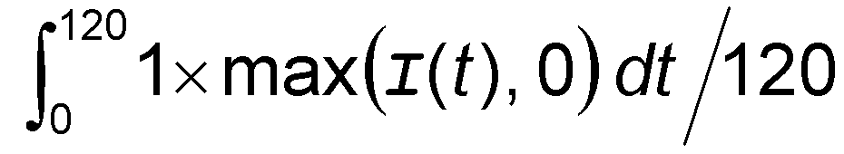
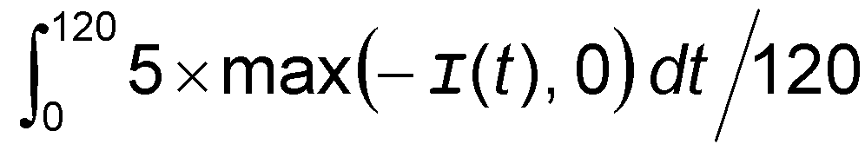
Model 5-4: (s, S) Inventory Simulation
Cost Structure
Average ordering cost per day
  When an order is placed, it incurs a fixed cost of $32, plus an incremental cost of $3 per item ordered
  If no order is placed at the beginning of a day, there’s no ordering cost, not even the fixed cost
  At end of simulation, divide total of ordering costs by 120
Average holding cost per day
  Whenever I(t) > 0, incur $1 per day per item on hand
  Average holding cost =
Average shortage cost per day
  Whenever I(t) < 0, incur $5 per day per item in backlog
  Average shortage cost =

Slide 7
Model 5-4: (s, S) Inventory Simulation
Cost Structure
During periods when I(t) = 0 there’s neither holding nor shortage cost incurred
Overall performance measure
= Average total cost per day
= Sum of average ordering, holding, and shortage costs per day
Don’t evaluate inventory at time 120
  We might order and incur an ordering cost then, but order will never arrive
  We’ll fudge this, but an Exercise asks you to do it right

Slide 8
Model 5-4: (s, S) Inventory Simulation
Data Structure
The text book uses Blocks, Elements panels exclusively
  Even for Variables, Expressions, Atltributes, Entities, statistics collection, and run control.
  This is done in order to introduce the lower level blocks in the Simian language.
  You may explore that if you wish.
  But, this can be built rather simply with just the Basic and Advanced Panels.
    This is Exercise 5-17 which we will look at instead.
  We won't go into a lot of detail here as the basic ideas are rather straight forward.

Slide 9
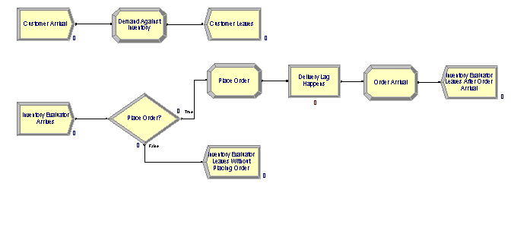
Investigate the Logic for Inventory
Note: Inventory Evaluator is Like Daemon

Slide 10
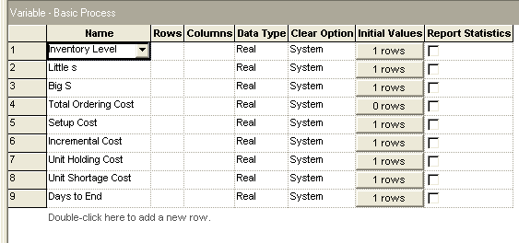
Variables – Same as Ones in Textbook, but Entered Through Basic Process Panel

Slide 11
Model 5-4: (s, S) Inventory Simulation
Data Structures
Variable (initialized, or default to 0 initially)
  Inventory Level = I(t), changes during run, initialized to 60
  Little s = s = 20
  Big S = S = 40
  Total Ordering Cost accumulator
  Setup Cost = 32
  Incremental Cost = 3
  Unit Holding Cost = 1
  Unit Shortage Cost = 5
  Days to Run = 119.9999 (The Fudge)

Slide 12
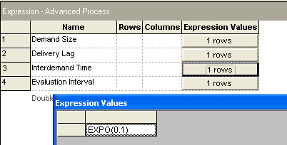
Model 5-4: (s, S) Inventory Simulation
Data Structures
Expressions element (in Advanced Process panel)
  Define Interdemand Time, Demand Size, Evaluation Interval, Delivery Lag

Slide 13
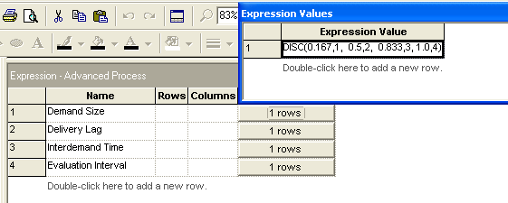
Model 5-4: (s, S) Inventory Simulation
Data Structures
Demand size is discrete random variable
  1, 2, 3, 4 with respective probabilities
  0.167, 0.333, 0.333, 0.167
Cumulative probabilities are specified in DISC function for Demand Size

Slide 14
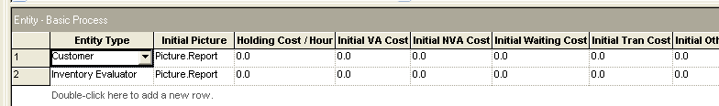
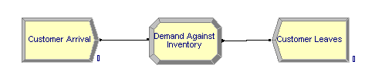
Logic for Customer – Very Simple
Two entities: Customer and Inventory Evaluator

Slide 15
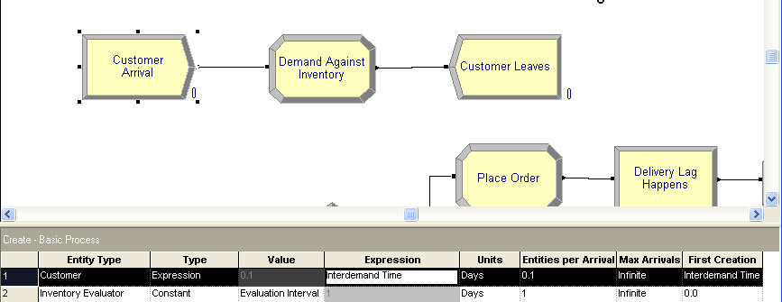
Create Module Creates Customer

Slide 16
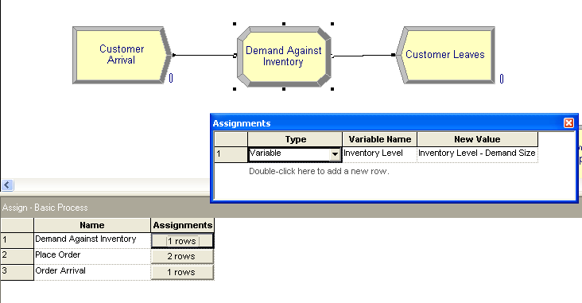
Demand Against Inventory Handles Customer Making a Purchase and Customer Then Leaves

Slide 17
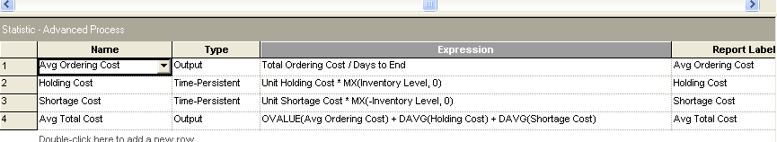
Statistics Module Defines User-specified Statistics to Maintain
MX is a function that returns the maximum of its arguments.
OVALUE is a function the returns the last (i.e. most recent) value of its argument.
DAVG returns the time-persistent average of its argument.

Slide 18
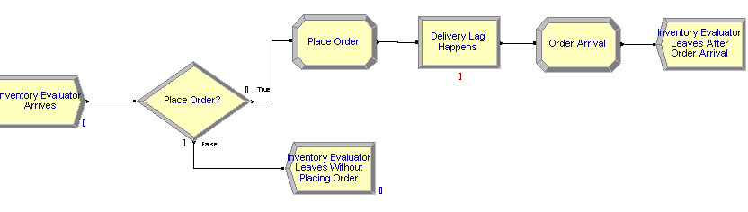
Inventory Evaluator Logic
Another entity, the inventory evaluator, is used to perform some work in the model – in this case, check the inventory and either place and order or not.

Slide 19
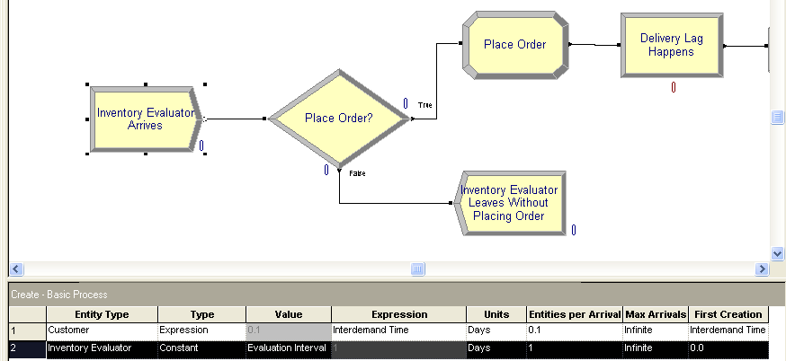
Create an Inventory Evaluator

Slide 20
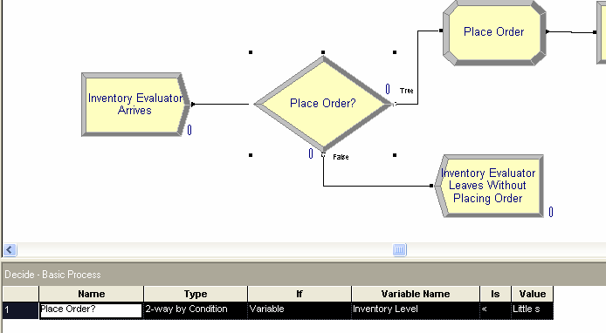
2-Way By Condition Decide Module for Deciding Whether or Not to Order.
If Not, Depart.

Slide 21
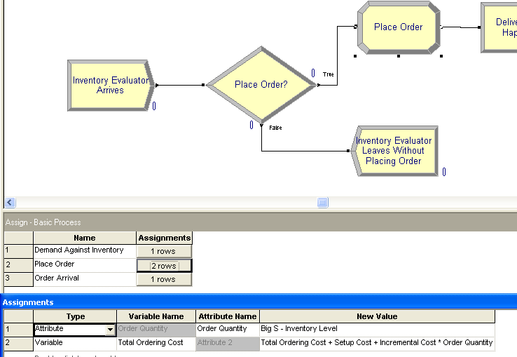
Otherwise, Place an Order

Slide 22
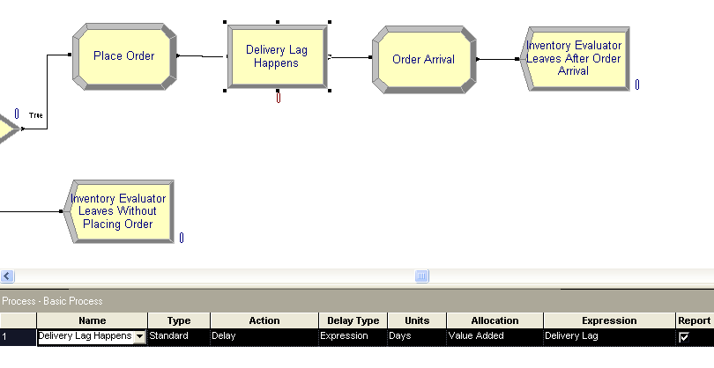
Process Delivery Lag With Expression Set Earlier to UNIF(0.5,1.0)

Slide 23
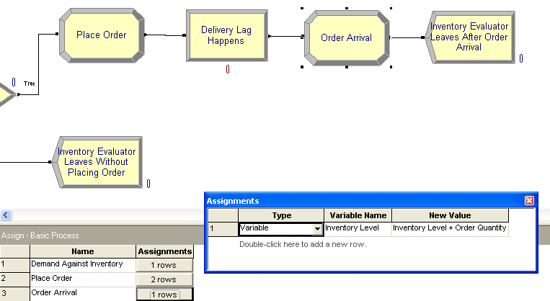
An Order Arrives and Inventory Evaluator Departs

Slide 24
Model 5-4: (s, S) Inventory Simulation
Animation
Plot separate “in the black” and “in the red” curves
  If in backlog, red curve will be plotted in negative direction due to its Expression
Pair of Level (“thermometer”) animations
  Fill Direction for “in the red” is Down
You can investigate the low-level programming if you wish.

Slide 25
Not in Text – Getting Output from Simulation
Most of the statistical information is provided in the reports at the end.
This is for seeing data that normally doesn't have anything to do with statistics.
For example, Joe is manipulating strings of DNA in his simulation and he needed to print changes that were made to the DNA.
I thought it would be helpful for everyone to see how the Write module works.
That module is also a Read module and once you understand the Write, I think you will understand the Read.
The problem is you need to know something about C input/output formatting of data.

Slide 26
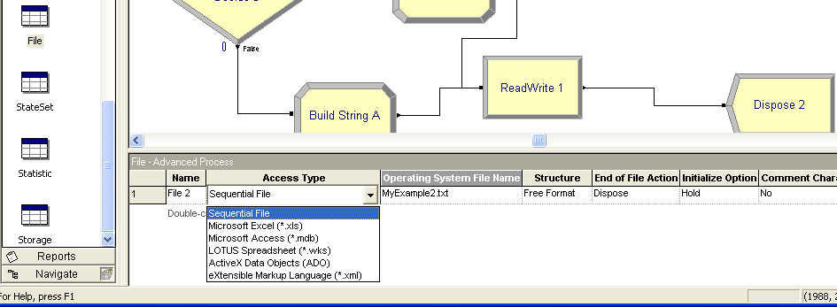
File Module
Arena allows writing to a wide range of file types.
We'll only look at a sequential file – i.e. text file.
For a write, a Notepad file of name MyExample2.txt will be created when a run starts.

Slide 27
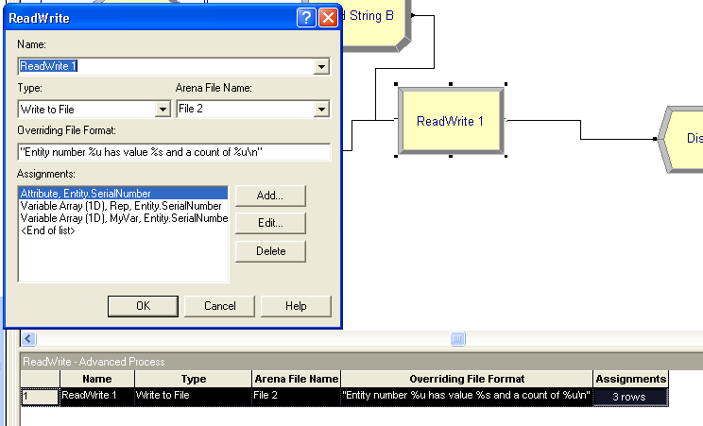
Read/Write Module

Slide 28
Overriding File Format
"Entity number %u has value %s and a count of %u\n"
This is a C language formatting statement which says what should be printed,
In C, this would be followed by 3 variables: an unsigned integer, a string, and another unsigned integer.
When a line is to be produced, the first unsigned integer would be substituted for the first %u, the string for the %s, and the second unsigned integer for the second %u.
The \n is a carriage return.
In Arena, those variables are added in the dialog box.

Slide 29
Read/Write Module

Slide 30
This Would Produce
Probably want to assign some value if no string is built.
Entity number 1 has value TB and a count of 1
Entity number 2 has value CB and a count of 1
Entity number 3 has value and a count of 0
Entity number 4 has value and a count of 0
Entity number 5 has value CB and a count of 1
Entity number 6 has value TA and a count of 1
Entity number 7 has value and a count of 0
Entity number 8 has value and a count of 0
Entity number 9 has value and a count of 0
Entity number 10 has value TB and a count of 1

Slide 31
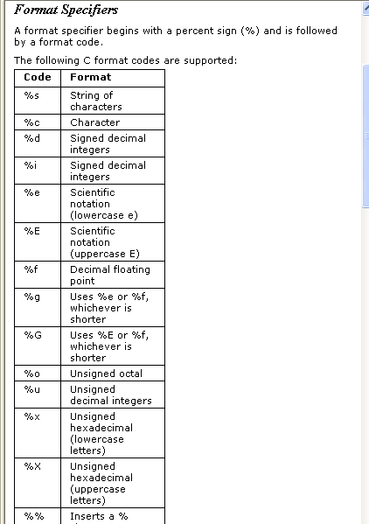

Slide 32
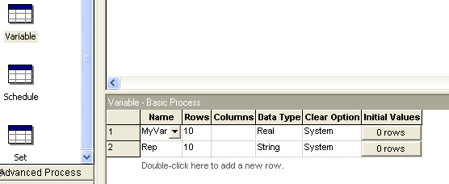
Strings are Supported as a Type in Version 11.0 and Can Be Declared Like Any Other Type – See Help for String Functions
Defines two arrays of 10 elements each – one has real elements and the other string elements.

